Slide 1

PERSONAL DATA
Written by Luu Quoc Thang
Apply for Software Engineer

Slide 2

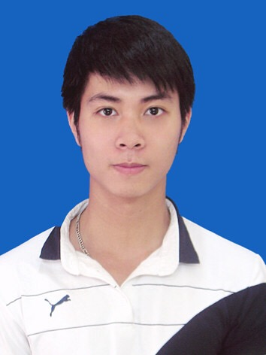
1. Persional Information
Name | Luu Quoc Thang
Date of birth | 18/07/1994
Gender | Male
Address | 12, Dai Mo, Nam Tu Liem, Ha Noi
Telephone | (+084) 0364384662
Email | thanglq.l2t@gmail.com
Time work in IT | 2 year
Current Position | Developer
2
Hi,

Slide 3
2. Education
University:
From August 2012 to June 2017: Student of Posts and Telecommunications Institute of Technology(PTIT)
Major: Information Technology- Software Technology
GPA (current): 7.1/10
Certificate: TOEIC 550, Examination at FPT Software,
CCNA Certificate
3

Slide 4
3. Personal Skills
Technical skills | Years of experiences | Last used
Programming Languages C#, C/ C++ VB.NET, Java | 2 year 2 year <1 year | 2017 – 2018 2015 – 2017
IDE/API/Programming tools Visual Studio Eclipse | 3 year 1 year | 2015 – 2018 2015 - 2016
CM tools TortoiseSVN | 2 year | 2015 – 2017
Database SQL AnyWhere My SQL SQL Server | 1 year | 2015 – 2016
5

Slide 5
4. EMPLOYMENT HISTORY
Time | Company | Role | Location
11/2017 – 11/2018 | FPT-Software (P3) | Developer | Hanoi, Vietnam
07/2017 – 11/2017 | FPT-Software (F500) | Developer | Hanoi, Vietnam
02/2017 – 6/2017 | FPT-Software (FGA.FTEST) | Developer | Hanoi, Vietnam
05/2016 – 12/2017 | CDIT | Developer | Hanoi, Vietnam
4

Slide 6
5. Projects: Geely_CMA_SWIT
2/2017-6/2017
Project name: Geely_CMA_SWIT (FPT’s Project in cooperation with LGE)
Build and update Customer's source code to run in virtual environment, coding for Linux, conduct SW integration test
Position: Developer and Tester
Programming language: C++
Tools/Hardware: QT Creator, Shell
OS: Linux
Task: Build and update Customer's source -> write TestCase ->Create test Project
6

Slide 7
5. Projects: GLOVIA
7/2017-10/2017
Project name: GLOVIA (FPT’s Project in cooperation with A Japanese company)
This is the customer's accounting system. Create new 18 item based on customer Design. The FPT team will create batch files and .exe files and then perform tests on the client environment.
Position: Developer
Programming language: VB.NET, Batch Script
Tools/Hardware: Visual Studio 2008
OS: Windows 7 64bit, Windows Server 2008
Task: Create Batch Script for Web server, Create .exe files, Migrate .Net 2.0 to .Net 3.5
7

Slide 8
5. Projects: M35
11/2017-11/2018
Project name: M35 (FPT’s Project in cooperation with A Japanese company)
Rebuild an ERP system from legacy system for a Japanese Customer. The ERP system has 7 sub systems: Financial, Salary, Assets, W/F, Sales,Tax.
Position: Developer
Programming language: C#, Angular 4
Tools/Hardware: Visual Studio 2017, VS Code
OS: Windows 10 64bit
Task: Create Internal Design from External Design, Implement coding, Do Unit Testing and Functional Testing
7

Slide 9
5. Other (Import Test Data)
Tool by me for M35 Project:
Import Test Data to Database
Tester: The creation progress of data had to save CSV files therefore it was quite complicated. Fortunately, there was a tool supporting reading excel files to generate query files then import those query files into data base.
Programming language: C#
7

Slide 10
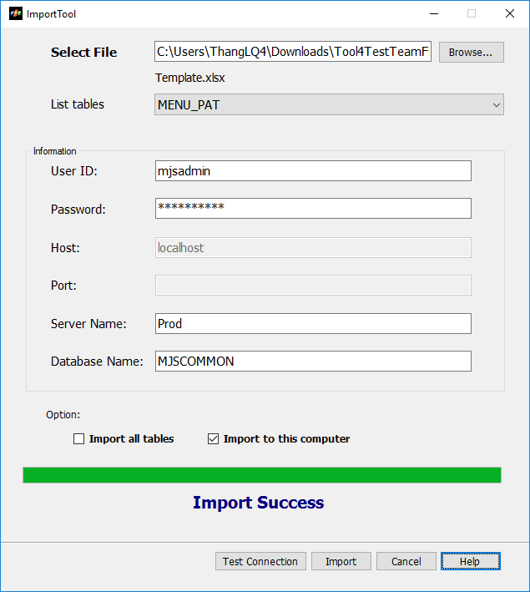
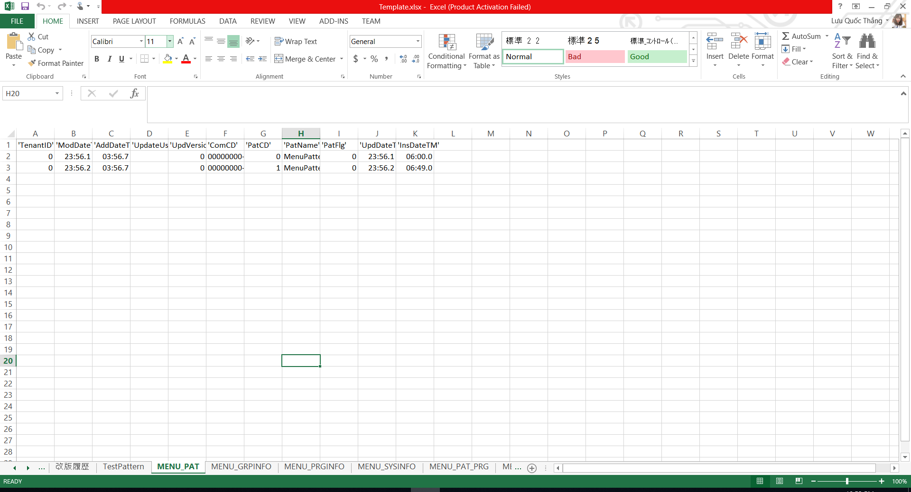
5. Other (Import Test Data)
Tool by me for M35 Project:
Import Test Data to Database
Template.xlsx
7

Slide 11
5. Other (SQL AnyWhere Tool)
Tool by me for M35 Project:
SQL AnyWhere Tool
Developer: This tool support auto import stored procedure to Database.
Programming language: C#
7

Slide 12
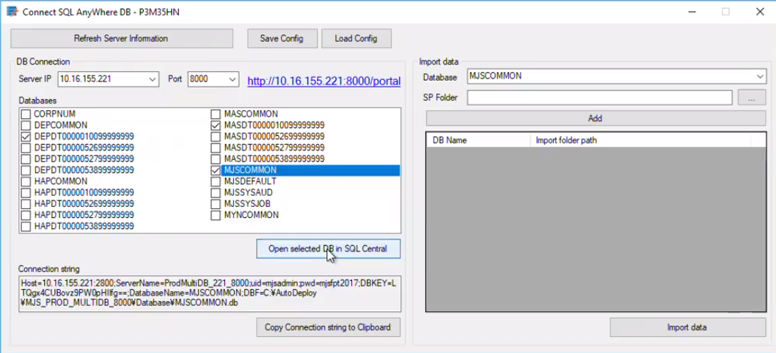
5. Other (SQL AnyWhere Tool)
Tool by me for M35 Project:
SQL AnyWhere Tool
7

Slide 13
5. Other (Build and Deploy)
Tool by me for M35 Project:
3. Build and Deploy Tool
The source code will be automatically built and deployed to IIS.
The database will be deployed as window services with the support of SQL AnyWhere.
Programming language: MSBuild, PowerShell, Batch Script
7

Slide 14
6. Future Plans
Knowledge:
Learn more about linux, Qt framework, linux core
Learn more about AI and Python
Study English
Rank:
Become excellent software engineer
Become software solutions architect or project manager within 3 years
8

